Slide 1
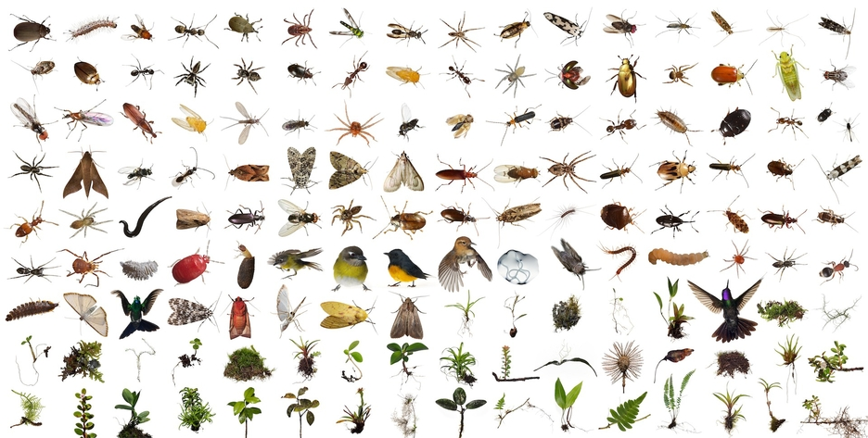

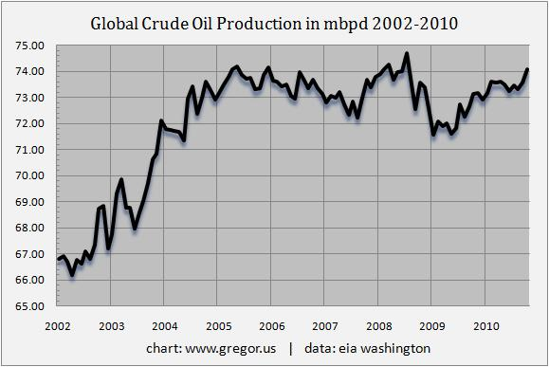
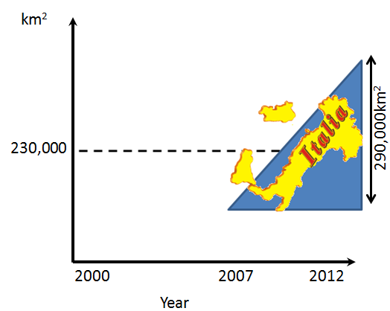
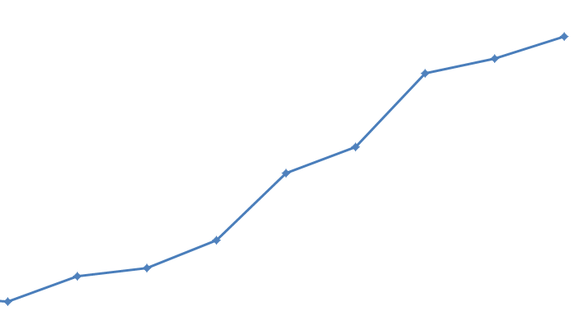
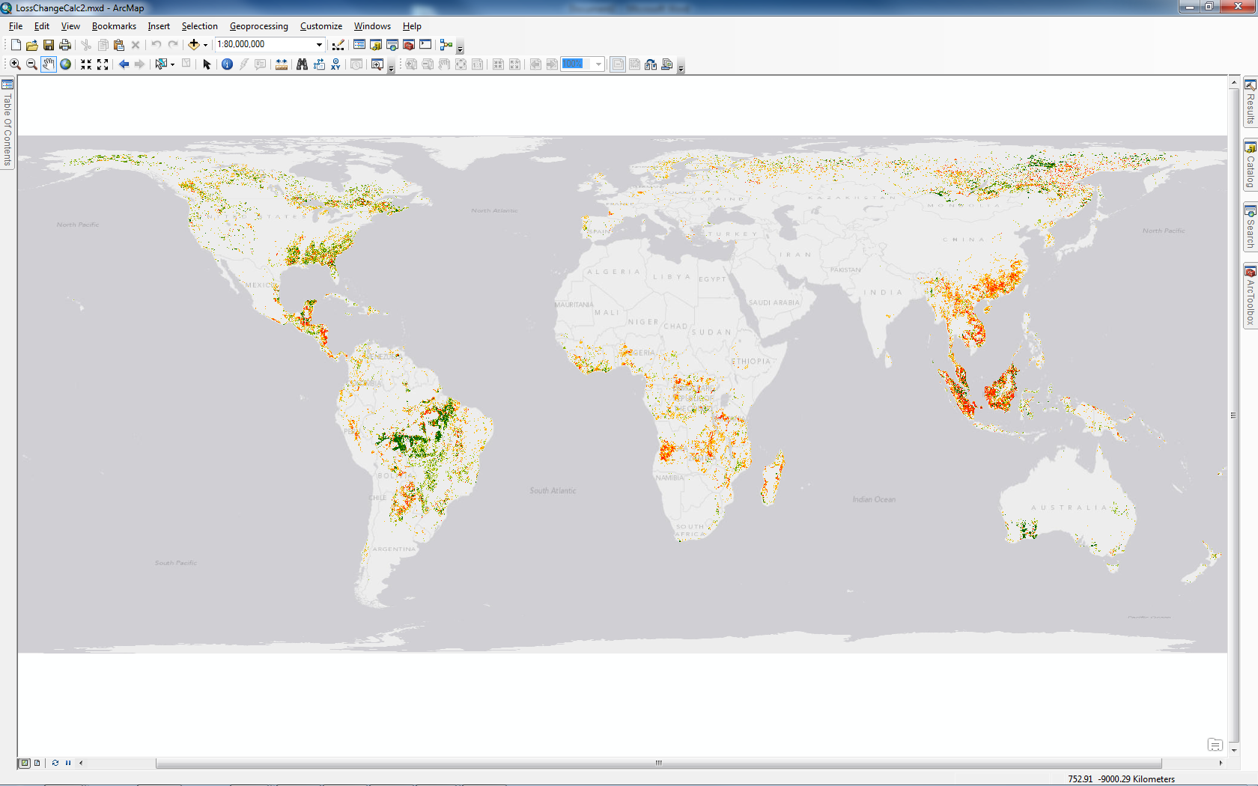
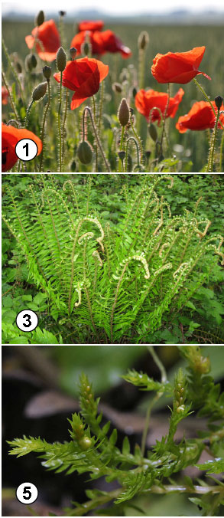
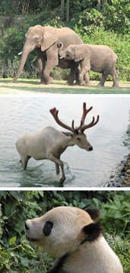

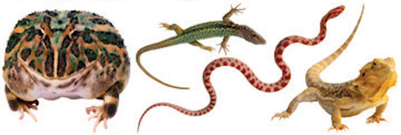
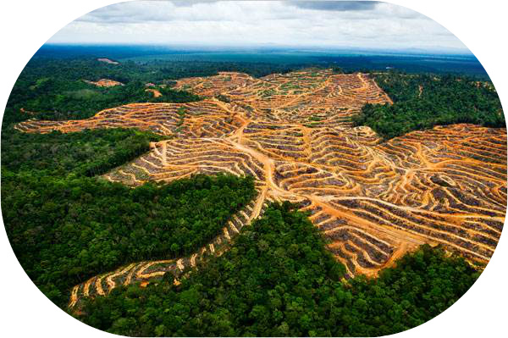
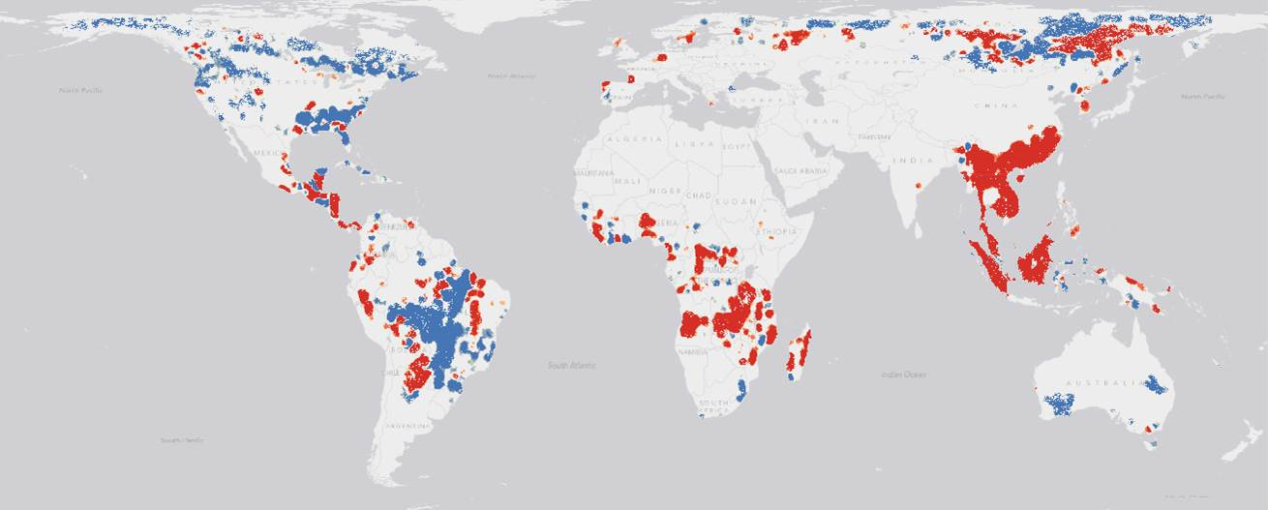
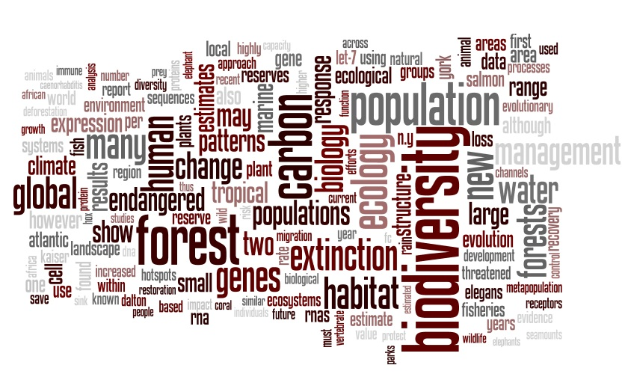
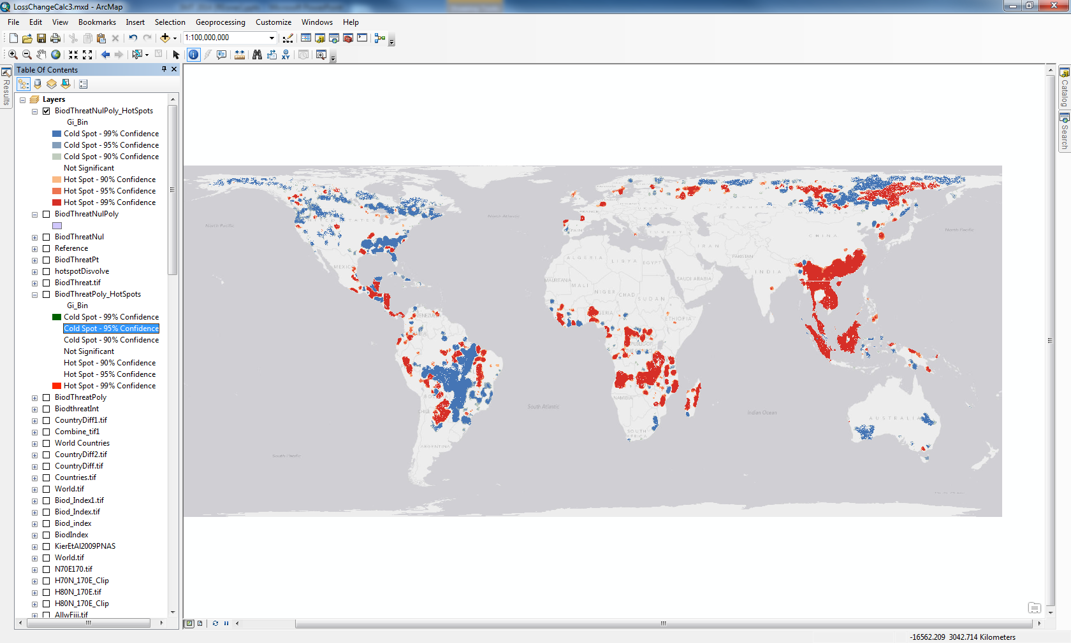
Has limited oil production increased the threat to biodiversity?
Rowan Eisner, PhD candidate, supervised by Clive McAlpine and Leonie Seabrook
Why would global oil constraints threaten biodiversity?
The alternatives to conventional oil need much more land
  Wind, solar, biofuels, shale oil, coal seam gas, tar sands
Fertilisers get expensive, poor farmers can’t afford them and farm less intensively
Food importing countries get worried about food and fuel insecurity and acquire land to meet future needs
Increasing commodity prices make land speculation attractive
  Although land grabbing doesn’t seem to be a major factor yet (R²=0.07, based on Land Matrix and Grain data 2013)
Forest loss
Global land grab
Oil production
Global food crisis
We’ve lost an extra area the size of Italy due to the increased rate of deforestation since 2006
Global financial crisis
Global oil production levelled off in 2005 and this has been linked to the GFC, the global land grab and the global food crises.
Threat to biodiversity from change in deforestation rate 2000 to 2012
Threat to biodiversity was calculated using the known ranges of…
Vascular plants
Mammals
Birds
Biodiversity threat
Amphibians and reptiles
Increasing
Decreasing
…taking into account
richness and endemism,
using the data of Kier et al 2009.
Hotspots of increased biodiversity threat
To map the threat to biodiversity I calculated the change in deforestation rate using Hansen’s 30m LossYear dataset and factored in biodiversity to see where it is most impacted.
Statistically, the areas where the threat to biodiversity has increased the most
But in some places policy may be working
The Amazon deforestation prevention plan in Brazil
The vegetation management act in Queensland
What’s happening in southern Western Australia?

